Slide 1
Linked Lists
A linked list is a group of nodes. Each node contains a value and a
reference to the next node in
the list.

Slide 2
Simple Node Class
public class Node
{
private Comparable data;
private Node next;
public Node(Comparable dat, Node nxt)
{
data=dat;
next=nxt;
}
}

Slide 3
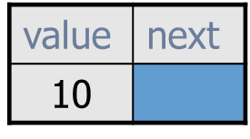
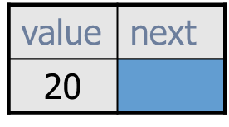
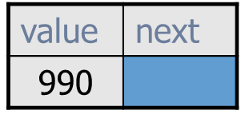
Typical Linked List
list is a reference variable that stores a reference to the first node. It does not store 10!
Each node stores a value AND a reference to the node that follows it.
list
...
A more streamlined representation:
10
20
990
list
...

Slide 4
A Single Node
0xF2
node
B
null
0xF2
A node typically has a data
component and a reference
to the next node.

Slide 5
Some draw the null reference this way!
0xF2
node
B
null
0xF2
This leads to the misconception that the “B” node points to a node that stores a null value, but there simply is no node after the “B” node.

Slide 6
Contexts we’ll work with:
Nodes only, which means you only have access to the setValue, setNext, getValue, and getNext methods. There’s no enclosing class, no no add or remove methods (for example) and no iterators!
Nodes that are stored as instance variables in an enclosing class, so we can access each node’s methods and any methods of our class, but nothing else exists. Still no iterators or for-each loops.
If we’re working with Java’s LinkedList class, then we have access to everything, including iterators and for-each loops.

Slide 7
Call node methods directly
ListNode x = new ListNode("10", null);
ListNode y = new ListNode("11", x);
ListNode z = new ListNode("12", y);
0x12
0x15
0x17
z
12
0x15
11
0x17
10
null
0x12
setValue(Comparable v)
setNext(Linkable next)
getValue()
getNext()
setValue(Comparable v)
setNext(Linkable next)
getValue()
getNext()
setValue(Comparable v)
setNext(Linkable next)
getValue()
getNext()
y
x
0x15
0x17
out.println(y.getValue()); 11
out.println(z.getNext().getValue()); 11

Slide 8
Call node methods directly
0xB3A
0x2CB
0xFEA
front
0xB3A
pig
0x2CB
dog
0xFEA
cat
null
setValue(Comparable v)
setNext(Linkable next)
getValue()
getNext()
setValue(Comparable v)
setNext(Linkable next)
getValue()
getNext()
setValue(Comparable v)
setNext(Linkable next)
getValue()
getNext()
out.println(front.getValue()); pig
out.println(front.getNext().getValue()); dog
© A+ Computer Science - www.apluscompsci.com

Slide 9
Write methods with a node parameter
0xB3A
0x2CB
0xFEA
front
0xB3A
pig
0x2CB
dog
0xFEA
cat
null
setValue(Comparable v)
setNext(Linkable next)
getValue()
getNext()
setValue(Comparable v)
setNext(Linkable next)
getValue()
getNext()
setValue(Comparable v)
setNext(Linkable next)
getValue()
getNext()
ListFun_Static class
static void print(ListNode list)
static int nodeCount(ListNode list)
static void doubleFirst(ListNode list)
static void doubleLast(ListNode list)
static void skipEveryOther(ListNode list)
© A+ Computer Science - www.apluscompsci.com

Slide 10
The front is an instance variable
ListFun
front = 0xB3A
void add(Comparable data)
void print()
int nodeCount()
void doubleFirst()
void doubleLast()
void skipEveryOther()
0xB3A
0x2CB
0xFEA
pig
0x2CB
dog
0xFEA
cat
null
setValue(Comparable v)
setNext(Linkable next)
getValue()
getNext()
setValue(Comparable v)
setNext(Linkable next)
getValue()
getNext()
setValue(Comparable v)
setNext(Linkable next)
getValue()
getNext()

Slide 11
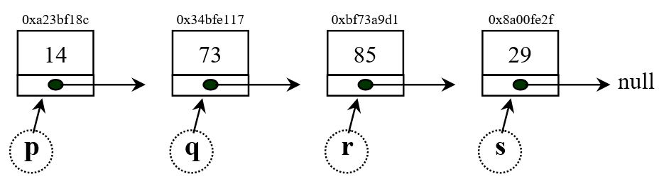
Directions: Show what the following commands do to the given diagram of a linked list. Draw an arrow to demonstrate the result of the command.
s = q.getNext();
Notes:
s originally stored a link to the 29 node (i.e. the node object that stores a value of 29).
Now s stores a link to the 85 node.

Slide 12

Directions: Show what the following commands do to the given diagram of a linked list. Draw an arrow to demonstrate the result of the command.
s.setNext(q.getNext());
Notes:
s originally stored a link to the 29 node (i.e. the node object that stores a value of 29).
Now s stores a link to the 85 node.

Slide 13
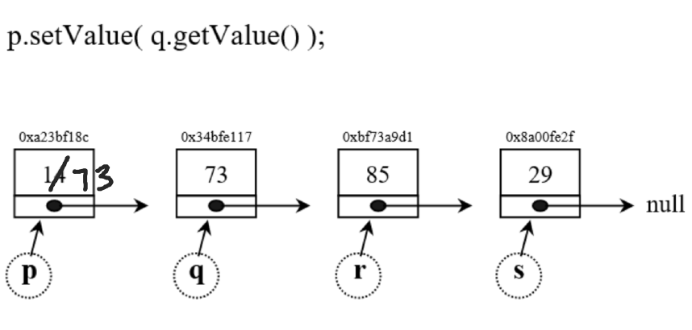

Slide 14
